Slide 1
How to Build a Workflow
Improving Digital Content Appraisal and Processing at the University of Illinois Library
Bethany Anderson, Joanne Kaczmarek, and Tracy Popp
University of Illinois Library
SAA Research Forum, August 5, 2020

Slide 2
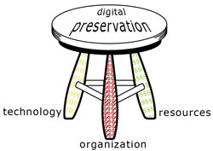
In the beginning…
building
thinking
learning
building
hiring
hiring
thinking
Medusa
learning
learning
Growing…
Growing…
growing……

Slide 3
Today’s landscape
Many Technologies and Services
Digitization Services
Institutional Repository
Preservation Repository
Illinois Data Bank
Digital Library
Dedicated Staff
Media Format
Digitization
Digital Preservation
Software Coders
Media Reformatting
Many Content Types & Formats
Scholarship
Research Data
Books
Newspapers
Special Collections
PDF, DOC, XLS, PST, CVS, etc.
Many Other Staff
Rare Books
Archives
Library

Slide 4
Steps toward success
Find some friends! (IDCAP – Improving Digital Content Appraisal & Processing)
Identify a senior-level champion (Associate University Librarian)
Learn together (webinars, readings, shared documents)
Start with what you know
Use a proven methodology (Project Management Institute)
Collect some data
Set a time limit

Slide 5
Start with what you know
From Tracy M. Popp, "Developing Policies, Procedures and Workflows for Stewarding Born Digital Collections in the University Library and University Archives at the University Of Illinois Urbana-Champaign," IDEALS, 2013, http://hdl.handle.net/2142/106638

Slide 6
Current flowchart for University Archives' workflow. Available at: https://docs.google.com/drawings/d/1sKptZVyML1J0XTTlj0yZRiWcnpxZwhvKq5BDF2RtUgs/edit?usp=sharing

Slide 7
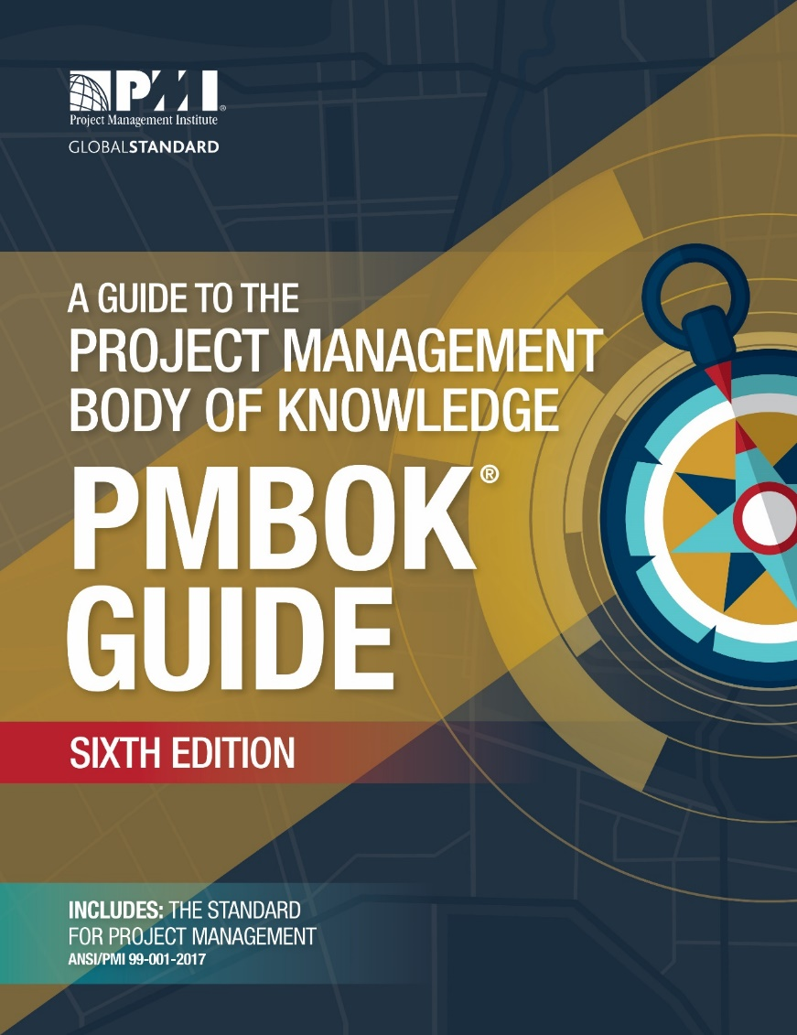
Use a proven methodology
http://pimbok.org

Slide 8
Collect some data
(Use Cases Template)

Slide 9
Use cases summary
Profile | Content Types | File Formats | Deposit Frequency
Student Organizations | Corresp, Pubs, Web, Photos, Gov. Docs, Mtgs, Sound/Film, Events/Training | All | Unknown
Administrative Records | Corresp, Pubs, Web, Photos, Governing Docs, Mtgs, Events/Training | All | Annual
Individual Donors | Corresp, Pubs, Web, Photos, Sound/Film | All | One Time
Faculty | Corresp, Pubs, Photos, Data, Notebooks | All | One Time / Unknown
Associations | Corresp, Pubs, Web, Photos, Mtgs, Sound/Film, Events/Training | All | Annual

Slide 10
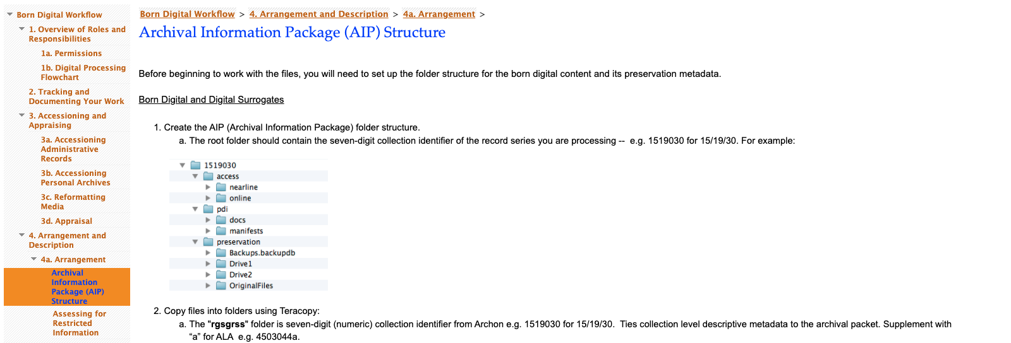
Rethinking workflows
Screenshot of current workflow documentation

Slide 11
Informal survey of workflow documentation
What does the digital workflow documentation landscape look like?
How are other institutions structuring their workflows?
How are other institutions representing their workflows?
What platforms do others use and where does documentation live?
Important to acknowledge that workflows exist in different environments, and speak to different needs, administrative structures, resources, and staffing models. And they are iterative and likely to change

Slide 12
The landscape of workflow documentation
*Thank you to Bridgette Hammond and Grace Moran for assisting with this survey

Slide 13
Preliminary survey results
Most institutions have made available high-level/policies but not workflows per se (many institutions have this); followed by flowcharts and instructions for digital forensics steps/tools and accessioning digital materials; to a lesser degree are step-by-step instructions for multiple activities through processing and ingest into a repository
Most workflows are organized by activity type
Information about labor and staffing models is often implicit
Platforms for hosting and representing websites vary greatly

Slide 14
Next steps
Find similarities across use cases that can be used to inform creation of workflow documentation
Develop formal survey to gather more information about workflow documentation from colleagues and share results
Conduct a gap analysis identifying strengths and weaknesses in existing digital preservation services and include recommended path toward evaluating and prioritizing gaps
The project should result in better support for the acquisition, processing of, and access to digital content by allowing for better planning and procurement of the IT infrastructure needed to support our various digital acquisitions and collections
The project should also benefit subject-matter experts and curators by providing more clear guidance on timelines for content processing based on priorities and available resources. This will allow subject-matter experts and curators to better plan their time spent on appraisal work and securing donor agreements

Slide 15
Thank you!
Bethany Anderson, Natural and Applied Sciences Archivist, bgandrsn@illinois.edu
Joanne Kaczmarek, Archivist for Electronic Records and Director of Records and Information Management, jkaczmar@illinois.edu
Tracy Popp, Digital Preservation Coordinator, tpopp2@illinois.edu

